Slide 1
Module 3: Part III
Module 3 Multiple Access
Dr. S.L.JAYALAKSHMI,
VIT Chennai

Slide 2
Outline
Three Categories
Random Access Protocols
Controlled Access Protocols
Channelization Protocols

Slide 3
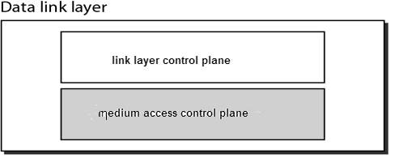
Multiple Access
In data link control protocols, dedicated link between the sender and receiver.
Data link layer divided into two functionality-oriented sublayers
Upper sublayer is responsible for data link (flow and error) control (Link Layer Control - LLC).
Lower sublayer is responsible for resolving access to the shared media (Medium Access Control - MAC).
Multiple access protocol coordinates to access the link (media).
Notes:
This Data Link Layer is divided into two sublayers:
Logical Link Control (LLC). This sublayer is responsible for the data transmission between computers or devices on a network.
Media Access Control (MAC). On a network, the network interface card (NIC) has an unique hardware address which identifies a computer or device. The physical address is utilized for the MAC sublayer addressing.

Slide 4
Multiple Access Protocols
Multiple Access Protocols
Random Access Protocols
Controlled Access Protocols
Channelization Protocols
Aloha
CSMA
CSMA-CD
CSMA-CA
Reservation
Polling
Token Passing
FDMA
TDMA
CDMA

Slide 5
Random Access Protocols
Rules of random access protocol
no station is master to another station
Every station is equal
No station permits, or not permit another station to send.
Instantly, a station that has data to send uses protocol (decision) on whether or not to send.

Slide 6
Random Access Protocols…
Two features of RAP are
Transmission is random among stations.
Stations compete with one another to access the medium.
Collision:
An access conflict occurs when more than one station tries to send, the frame is either destroyed or modified.

Slide 7
Aloha
Developed at the University of Hawaii (US) in early 1970 and designed for wireless LAN, but can be used on any shared medium.
Original ALOHA protocol is called pure ALOHA
A node sends the frame whenever it has a frame to send.
Medium is shared between the stations, there is possibility of collision between frames from different stations.

Slide 8
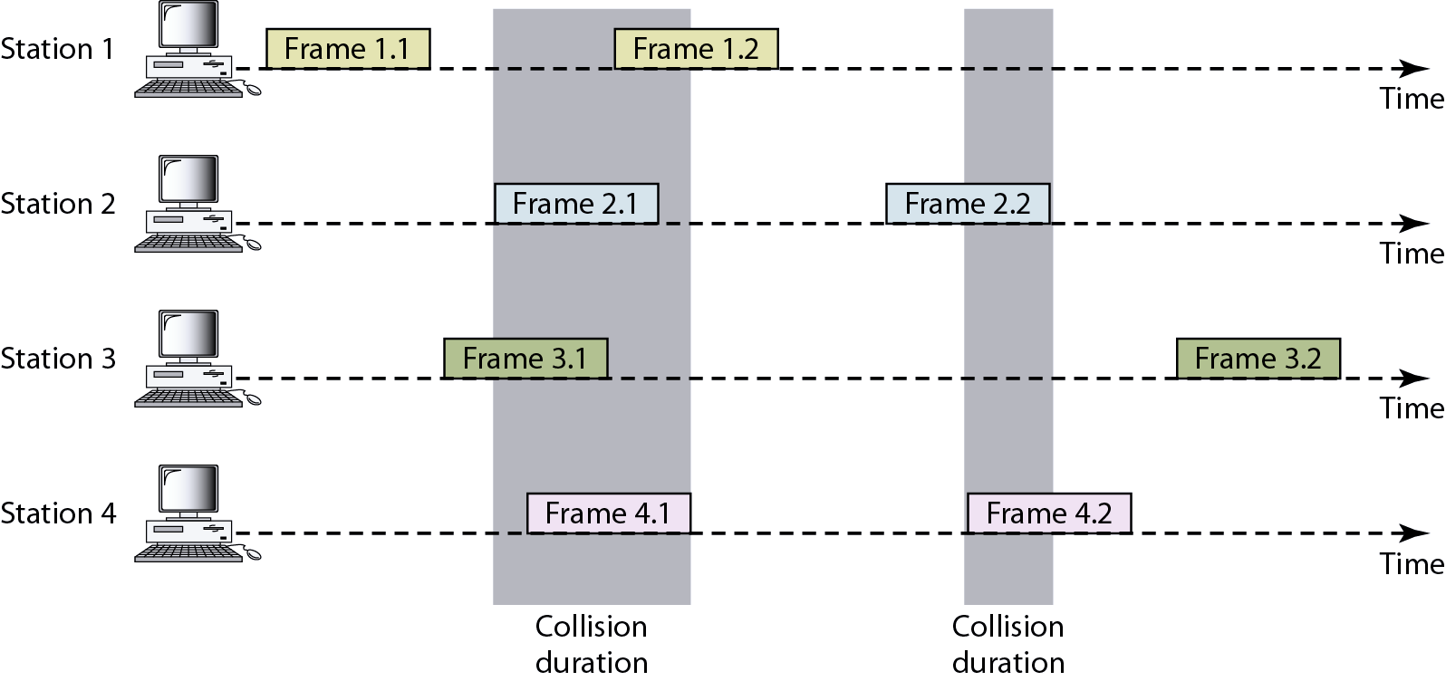
Pure Aloha

Slide 9
Aloha…
A collision involves two more stations. If all the stations try to send their frames after the time-out, the frames will collide again.
To avoid collision stations will try again in random period, this time is the back-off time TB.

Slide 10
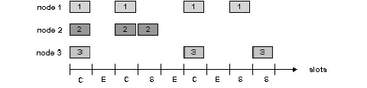
Slotted Aloha
All frames are of same size.
Time is divided into slots of size L/R seconds time (equal size slots)
L: Bandwidth and R: Time to transmit 1 frame
Start to transmit frames only at beginning of slots
Nodes are synchronized so that each node knows when the slots begin.
If two or more frames collide in a slot, then all the nodes detect the collision event before the slot ends.

Slide 11
Slotted Aloha…
When node obtains fresh frame, it transmits in next slot
If no collision is detected , node can send new frame in next slot
If collision, node retransmits frame in each subsequent slot with prob. p until success
The number of collisions is reduced. Hence, the performance becomes much better compared to Pure Aloha.

Slide 12
CSMA – Carrier Sense Multiple Access
To minimize the collision CSMA was developed, chance of collision was reduced
Station senses the channel before accessing medium.
The possibility of collision still exists because of propagation delay

Slide 13
Types of CSMA
1-Persistent Method
Non- Persistent Method
P-Persistent Method

Slide 14
1- Persistent Method
If the channel is idle it sends its frame immediately with probability 1
When two or more stations find the line idle and send their frames immediately to create collisions
Notes:
Basis 1-persistent CSMA p-persistent CSMA
Waiting It will continuously sense channel for transmission of frames. It will wait for next time slot for transmission of frames.

Slide 15
Non-Persistent Method
If the line is idle it sends its frame immediately.
If the line is busy it waits random amount of time and then senses the line again.
Reduces the collision because it is unlikely that two or more stations will wait the same amount of time and retry

Slide 16
P-Persistent Method
It applies to slotted channels.
It senses the channel, if it is idle, it transmits with a probability p.
With a probability q = 1 - p, it waits for the next slot.
If that slot is idle, it goes to step 1
If the line is busy it act as though collision has occurred and uses the back off procedure .

Slide 17
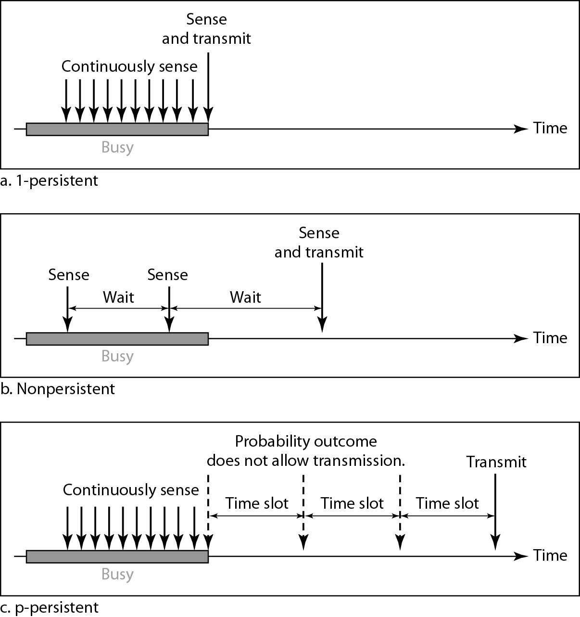

Slide 18
Carrier Sense Multiple Access with Collision Detection (CSMA-CD)
Abort their transmissions as soon as they detect a collision
Waits a random period of time, and then tries again, assuming that no other station has started transmitting in the meantime.
Frame transmission time must be two times the maximum propagation time: Tfr = 2 × Tp
Energy levels: zero, Normal, and Abnormal.
Notes:
Energy Level:
At the zero level, the channel is idle. At the normal level, a station has successfully captured the channel and is sending its frame. At the abnormal level, there is a collision and the level of the energy is twice the normal level.

Slide 19
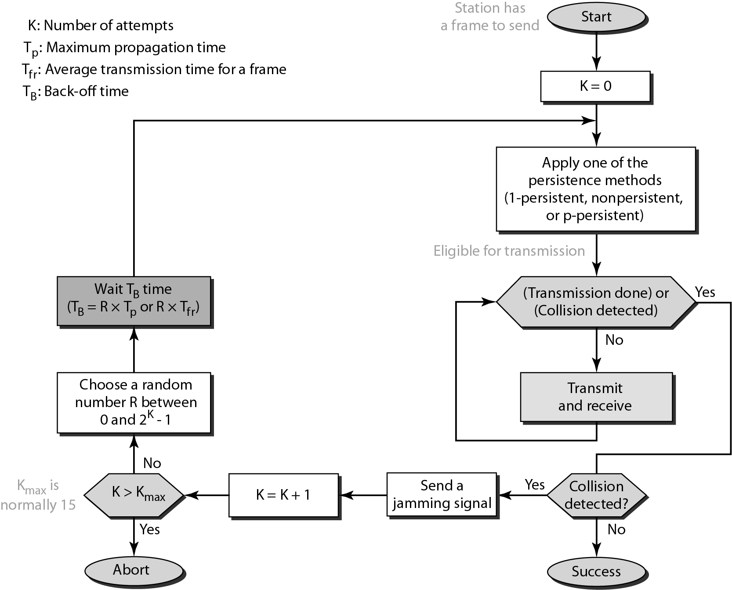

Slide 20
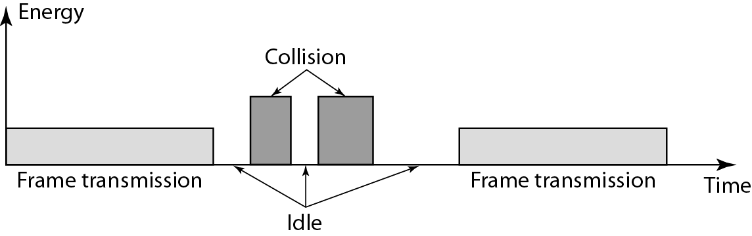
Energy Level during transmission, idleness, or collision

Slide 21
Carrier Sense Multiple Access with Collision Avoidance (CSMA-CA)
When there is collision the station receives two signals: its own and the signal transmitted by a second station.
In wired network received signal is the same as the sent signal (Losses are less).
In wireless network much of the sent energy is lost in transmission (Transmission Losses).
Avoid collision on wireless network because they cannot be detected.
Notes:
The basic idea behind CSMA/CA is that the station should be able to receive while transmitting to detect a collision from different stations. In wired networks, if a collision has occurred then the energy of received signal almost doubles and the station can sense the possibility of collision. In case of wireless networks, most of the energy is used for transmission and the energy of received signal increases by only 5-10% if a collision occurs. It can’t be used by the station to sense collision. Therefore CSMA/CA has been specially designed for wireless networks.
These are three types of strategies:
InterFrame Space (IFS) – When a station finds the channel busy, it waits for a period of time called IFS time. IFS can also be used to define the priority of a station or a frame. Higher the IFS lower is the priority.
Contention Window – It is the amount of time divided into slots.A station which is ready to send frames chooses random number of slots as wait time.
Acknowledgements – The positive acknowledgements and time-out timer can help guarantee a successful transmission of the frame.

Slide 22
CSMA-CA …
These are three types of strategies
InterFrame Space (IFS) :When channel is free waits for period of time called the interframe space or IFS.
Contention Window: After IFS time the station still waits to a time equal to the contention time .It is an amount of time divided into slots.
Acknowledgements : The positive acknowledgements and time-out timer can help guarantee a successful transmission of the frame.
Notes:
These are three types of strategies:
InterFrame Space (IFS) – When a station finds the channel idle, it waits for a period of time called IFS time. IFS can also be used to define the priority of a station or a frame. Higher the IFS lower is the priority.
Contention Window – It is the amount of time divided into slots. A station which is ready to send frames chooses random number of slots as wait time.
Acknowledgements – The positive acknowledgements and time-out timer can help guarantee a successful transmission of the frame.

Slide 23
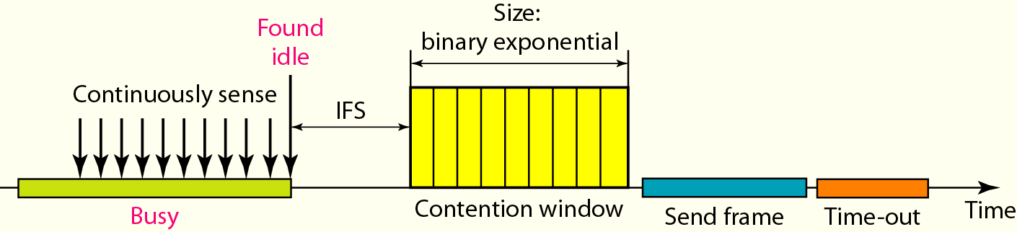
Timing in CSMA-CA

Slide 24
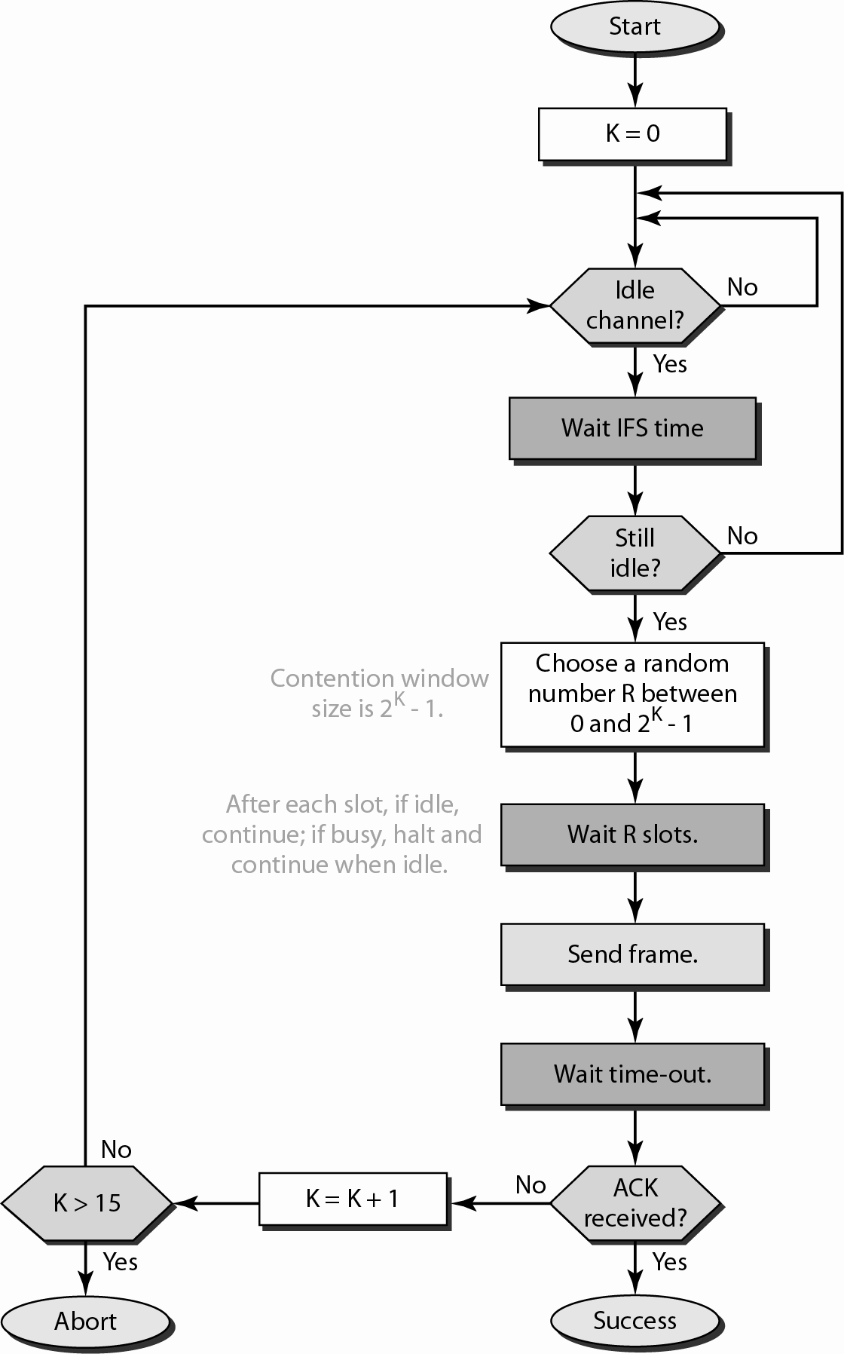

Slide 25
Controlled Access Protocols
In controlled access, the stations consult one another to find which station has the right to send. A station cannot send unless it has been authorized by other stations.
The three types of Controlled Access Protocols are
Reservation
Polling
Token Passing

Slide 26
Reservation Access Method
A station must make a reservation before sending data
Time is divided into intervals
A reservation frame proceeds each time interval
Number of stations and number of time slots in the reservation frame are equal
Each time slot belongs to a particular station
Notes:
In controlled access, the stations seek information from one another to find which station has the right to send. It allows only one node to send at a time, to avoid collision of messages on shared medium. The three controlled-access methods are:
Reservation
Polling
Token Passing
Reservation
In the reservation method, a station needs to make a reservation before sending data.
The time line has two kinds of periods:
Reservation interval of fixed time length
Data transmission period of variable frames.
If there are M stations, the reservation interval is divided into M slots, and each station has one slot.
Suppose if station 1 has a frame to send, it transmits 1 bit during the slot 1. No other station is allowed to transmit during this slot.
In general, i ^{th} station may announce that it has a frame to send by inserting a 1 bit into i ^{th} slot. After all N slots have been checked, each station knows which stations wish to transmit.
The stations which have reserved their slots transfer their frames in that order.
After data transmission period, next reservation interval begins.
Since everyone agrees on who goes next, there will never be any collisions.

Slide 27
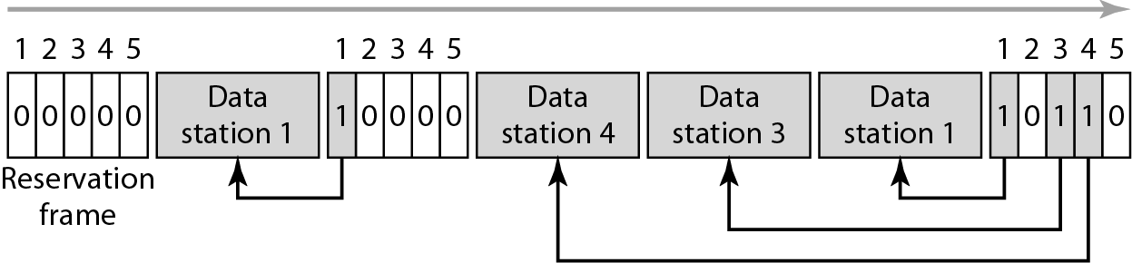
Reservation Access Method…
Notes:
The following figure shows a situation with five stations and a five slot reservation frame. In the first interval, only stations 1, 3, and 4 have made reservations. In the second interval, only station 1 has made a reservation.

Slide 28
Polling Method
Devices are categorized as
Primary Station (PS)
Secondary Station (SS)
All data exchange must go through the primary station
Primary station controls the link and initiates the session
Secondary station obey the instructions of PS.
1. PS polls stations
Asking SS if they have something to send
2. PS select a SS
Telling it to get ready to receive data

Slide 29
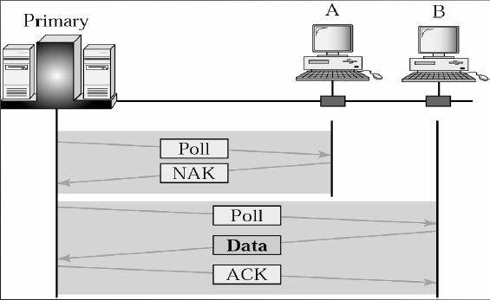
Primary Station (PS) polls stations
Notes:
Polling process is similar to the roll-call performed in class. Just like the teacher, a controller sends a message to each node in turn.
In this, one acts as a primary station(controller) and the others are secondary stations. All data exchanges must be made through the controller.
The message sent by the controller contains the address of the node being selected for granting access.
Although all nodes receive the message but the addressed one responds to it and sends data, if any. If there is no data, usually a “poll reject”(NAK) message is sent back.
Problems include high overhead of the polling messages and high dependence on the reliability of the controller.

Slide 30
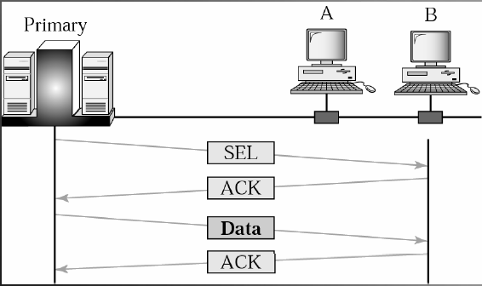
Primary Station select a Secondary Station

Slide 31
Token Passing Method
Stations in a network are organized in a logical ring, for each station, there is a predecessor and a successor
For a station to access the channel, it must posses a token (special packet) that gives the station the right to access the channel and send its data
Once the station has finished its task, the token will then be passed to the successor (next station)
The station cannot send data until it receives the token again in the next round
Token management is necessary
Every station is limited in the time of token possession
Token must be monitored to ensure no lose or destroyed
Assign priorities to the stations and to the types of data transmitted
To make low-priority stations release the token to high priority stations

Slide 32
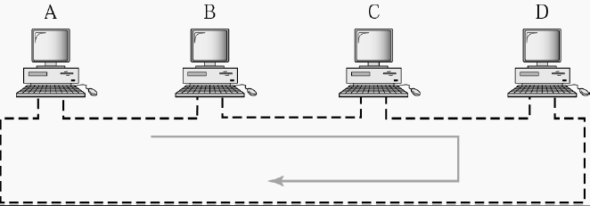
Token Passing Procedure

Slide 33
Channelization Method
Channelization is a multiple-access method. Here, available bandwidth of a link is shared in time, frequency, or through code, between different stations.
There are three types
Frequency-Division Multiple Access (FDMA)
Time-Division Multiple Access (TDMA)
Code-Division Multiple Access (CDMA)

Slide 34
Frequency Division Multiple Access (FDMA)
In FDMA, the available bandwidth of the common channel is divided into bands that are separated by guard bands.

Slide 35
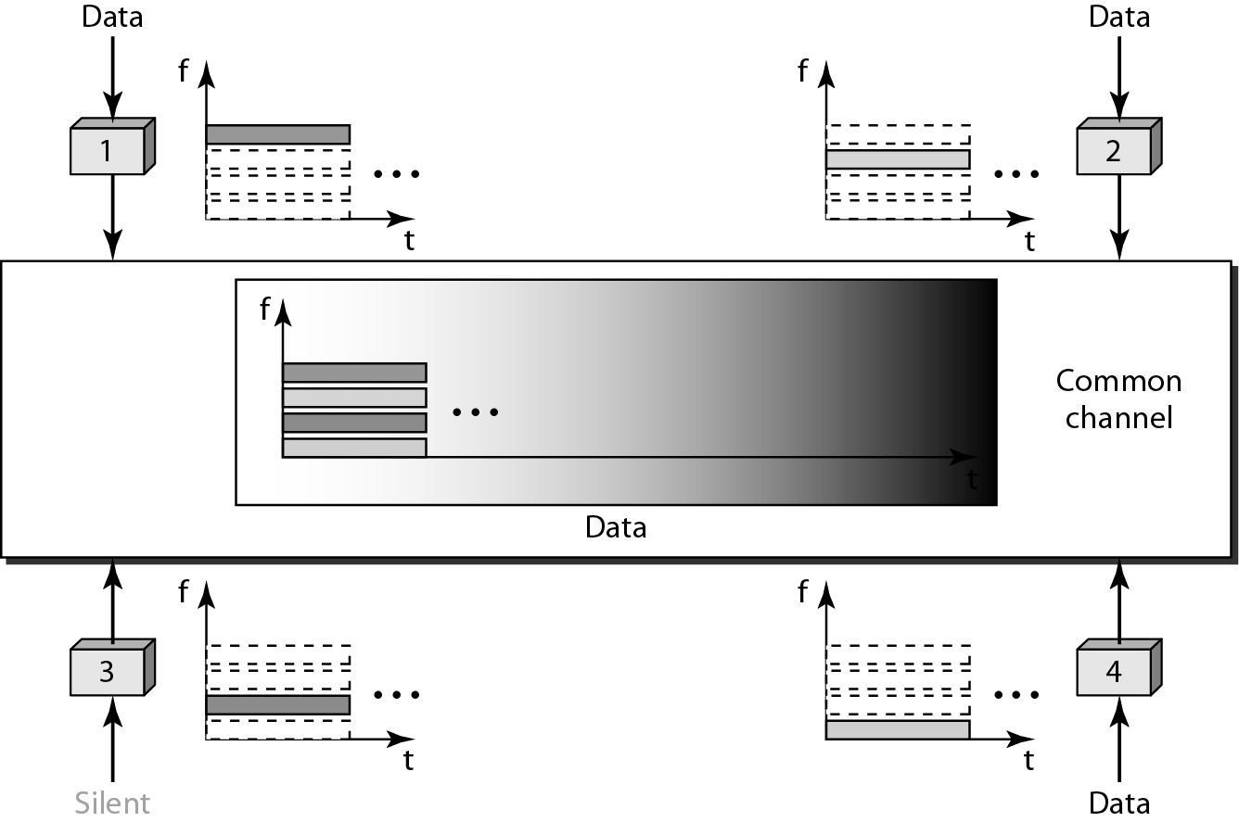
Frequency-division multiple access (FDMA)
Notes:
Frequency Division Multiple Access (FDMA) – The available bandwidth is divided into equal bands so that each station can be allocated its own band. Guard bands are also added so that no to bands overlap to avoid crosstalk and noise.

Slide 36
Time-Division Multiple Access (TDMA)
In TDMA, the bandwidth is just one channel that is timeshared between different stations.

Slide 37
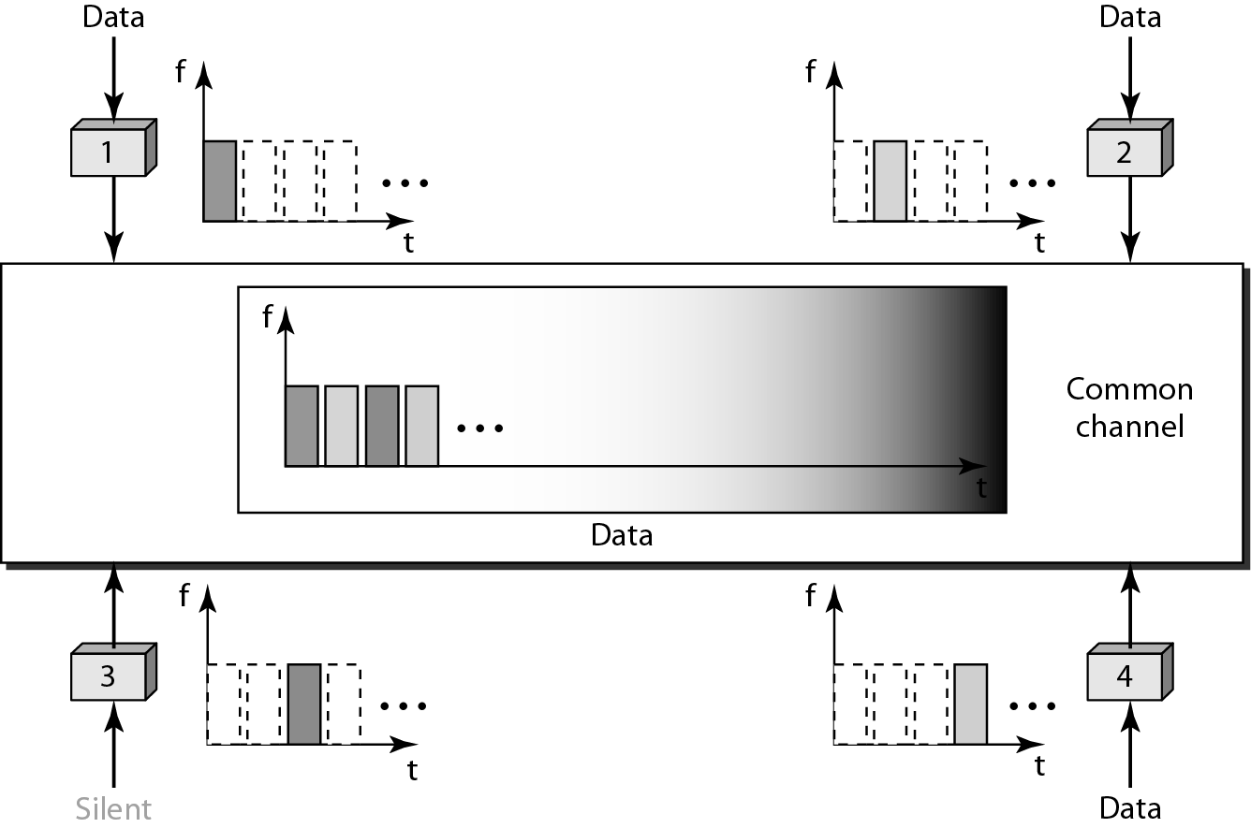
Time-Division Multiple Access (TDMA)

Slide 38
Code-Division Multiple Access (CDMA)
In CDMA, one channel carries all transmissions simultaneously.
Notes:
Code Division Multiple Access (CDMA) – One channel carries all transmissions simultaneously. There is neither division of bandwidth nor division of time. For example, if there are many people in a room all speaking at the same time, then also perfect reception of data is possible if only two person speak the same language. Similarly data from different stations can be transmitted simultaneously in different code languages.

Slide 39
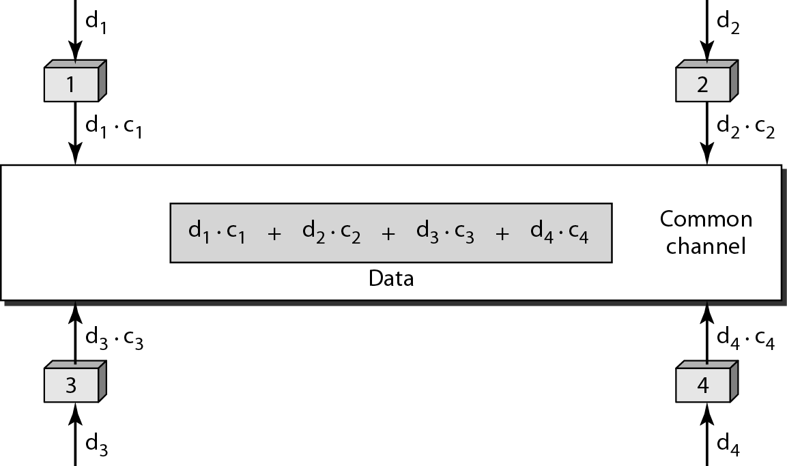
Code-Division Multiple Access (CDMA)

Slide 40
Framing
In the physical layer, data transmission involves synchronized transmission of bits from the source to the destination. The data link layer packs these bits into frames.
Data-link layer takes the packets from the Network Layer and encapsulates them into frames. If the frame size becomes too large, then the packet may be divided into small sized frames. Smaller sized frames makes flow control and error control more efficient.
Then, it sends each frame bit-by-bit on the hardware. At receiver’s end, data link layer picks up signals from hardware and assembles them into frames.

Slide 41
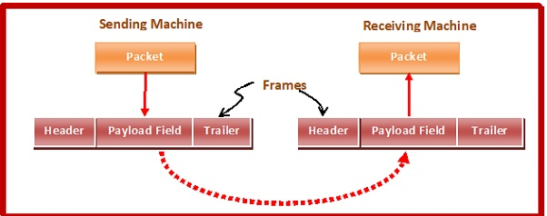
Framing

Slide 42

Parts of a Frame
A frame has the following parts −
Frame Header − It contains the source and the destination addresses of the frame.
Payload field − It contains the message to be delivered.
Trailer − It contains the error detection and error correction bits.
Flag − It marks the beginning and end of the frame.

Slide 43
Types of Framing
Framing can be of two types, fixed sized framing and variable sized framing.
Fixed-sized Framing
Here the size of the frame is fixed and so the frame length acts as delimiter of the frame. Consequently, it does not require additional boundary bits to identify the start and end of the frame.
Example − Asynchronous Transfer Mode (ATM) wide-area network, which uses frames of fixed size called cells.
Variable – Sized Framing
Here, the size of each frame to be transmitted may be different. So additional mechanisms are kept to mark the end of one frame and the beginning of the next frame.
It is used in local area networks.

Slide 44
Two ways to define frame delimiters in variable sized framing are −
Length Field − It is used that determines the size of the frame. It is used in Ethernet (IEEE 802.3).
End Delimiter − A pattern is used as a delimiter to determine the size of frame (used in token rings).
Two approaches
Byte – Stuffing(used in character oriented protocol) − A byte is stuffed in the message to differentiate from the delimiter. This is also called character-oriented framing.
Bit – Stuffing(used in bit oriented protocol) − A pattern of bits of arbitrary length is stuffed in the message to differentiate from the delimiter. This is also called bit – oriented framing.

Slide 45
Frame Formation in Datalink Layer
Bit Stuffing Method
Byte Stuffing Method

Slide 46

Bit Stuffing Method
Allows frame to contain arbitrary number of bits and arbitrary character size. The frames are separated by separating flag.
Each frame begins and ends with a special bit pattern, 01111110 called a flag byte. When five consecutive l's are encountered in the data, it automatically stuffs a '0' bit into outgoing bit stream.
In this method, frames contain an arbitrary number of bits and allow character codes with an arbitrary number of bits per character. In this case, each frame starts and ends with a special bit pattern, 01111110.
In the data a 0 bit is automatically stuffed into the outgoing bit stream whenever the sender's data link layer finds five consecutive 1s.

Slide 47
Bit Stuffing Method…
0 1 1 0 1 1 1 1 1 1 1 1 1 1 1 1 1 1 1 1 0 0 1 0
0 1 1 0 1 1 1 1 1 0 1 1 1 1 1 0 1 1 1 1 1 0 1 0 0 1 0
Stuffed Bits
(c) 0 1 1 0 1 1 1 1 1 1 1 1 1 1 1 1 1 1 1 1 0 0 1 0

Slide 48
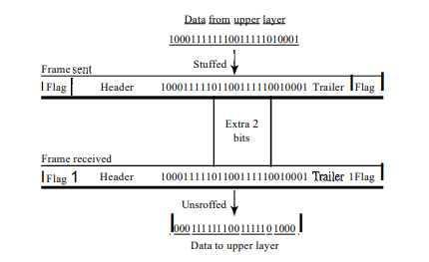
Note that even if we have a 0 after five 1s, we still stuff a O. The 0 will be removed by the receiver.
unstuffed

Slide 49
Byte Stuffing Method
Start and end of frame are recognized with the help of flag bytes.
Each frames starts with and ends with a “Flag Byte”.
Two consecutive flag bytes indicate the end of one frame and start of the next one.
The flag bytes used is named as “ESC” flag byte.
A frame delimited by flag bytes.
Disadvantage:
It is applicable for 8-bit character codes

Slide 50
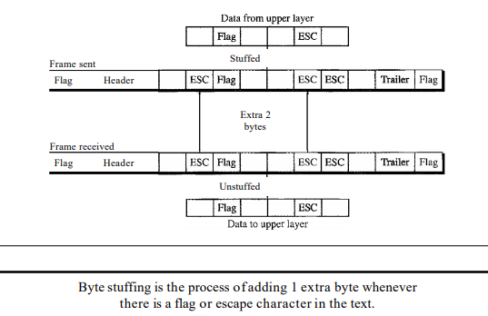

Slide 51
Byte Stuffing Method…
FLAG
Header
Payload Field
Trailer
FLAG
A
FLAG
B
A
ESC
FLAG
B
A
ESC
B
A
ESC
ESC
B
A
ESC
FLAG
B
A
ESC
ESC
ESC
FLAG
B
A
ESC
ESC
B
A
ESC
ESC
ESC
ESC
B
a. Original
b. After Stuffing

Slide 52
References
Computer Networks: A Systems Approach, Larry Peterson and Bruce Davie, 5th Ed, The Morgan Kaufmann Series, Elsevier, 2011.
Computer Networking: A Top-Down Approach Featuring the Internet, J. F. Kurose and K. W. Ross, 6th Ed., Pearson Education, 2012.
Data Communications and Networking, Behrouz A. Forouzan, McGraw Hill Education, 5th Ed., 2012
TCP/IP Protocol Suite, Behrouz A. Forouzan, McGraw-Hill Education, 4 Ed., 2009
Data and Computer Communications, William Stallings, Pearson Education, 10th Ed, 2013.

